Slide 1

Movies-computing p values
Ryan Coslove rmc326

Slide 2
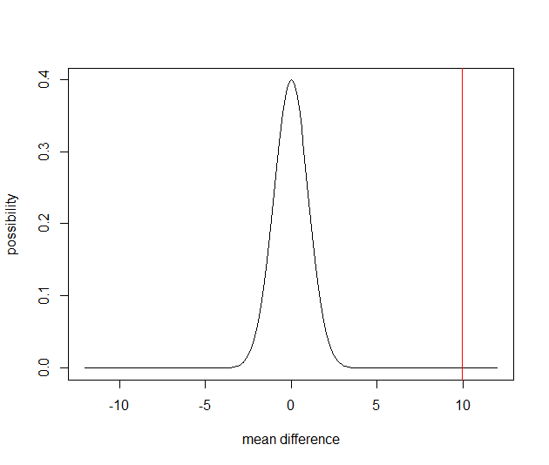
High Budget R movies have lower imdb scores than High Budget PG movies
The Null Hypothesis - High Budget R Movies have the same imdb scores as High Budget PG Movies
The Alternative Hypothesis – High Budget R movies have higher imdb scores than High Budget PG Movies
We found that our P value = 0.0
Therefore, we can reject the null and there is enough statistical evidence to infer that the alternative hypothesis is true.

Slide 3
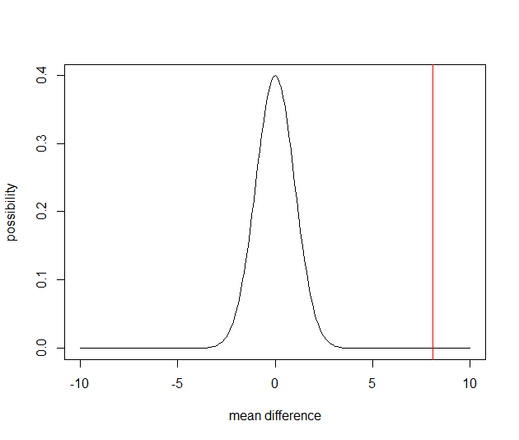
High Budget Sci-Fi movies have Lower imdb scores than high Budget Family movies
The Null Hypothesis - High Budget Sci-Fi Movies have the same imdb scores as Low Budget Family Movies
The Alternative Hypothesis – High Budget Sci-Fi movies have higher imdb scores than High Budget Family Movies
We found that our P value = 2.22044e-16
Therefore, we can reject the null and there is enough statistical evidence to infer that the alternative hypothesis is true.

Slide 4
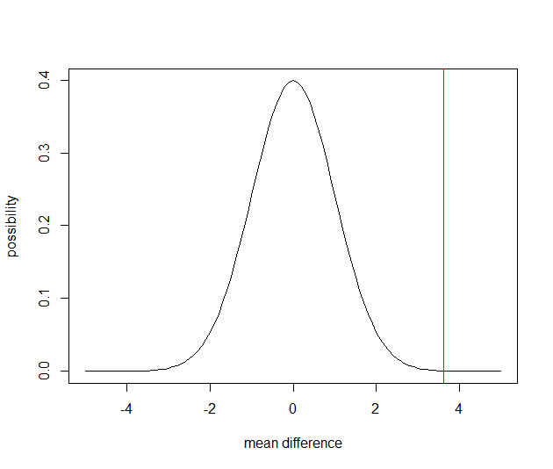
Low Gross Comedy Movies have higher imdb scores than High Gross Action Movies
The Null Hypothesis - Low Gross Comedy Movies have the same imdb scores than High Gross Action Movies
The Alternative Hypothesis – Low Gross Comedy Movies have lower imdb scores than High Gross Action Movies
We found that our P value = 0.00014989
Therefore, we can reject the null and there is enough statistical evidence to infer that the alternative hypothesis is true.

Slide 5
How we reached our conclusions
Using snippet 6.9 in the online data book, I used the template given to calculate standard deviations, means, z-scores and p-scores, and more.
Creating the appropriate subsets for A, B, and C, I was able to use proper data to test my hypotheses .
All 3 of my hypothesis resulted in p-values to be <0.05. This means we were able to reject the null hypothesis for all 3 and infer the alternative hypothesis to be true.
Code is provided in the attached R script.

